Slide 1
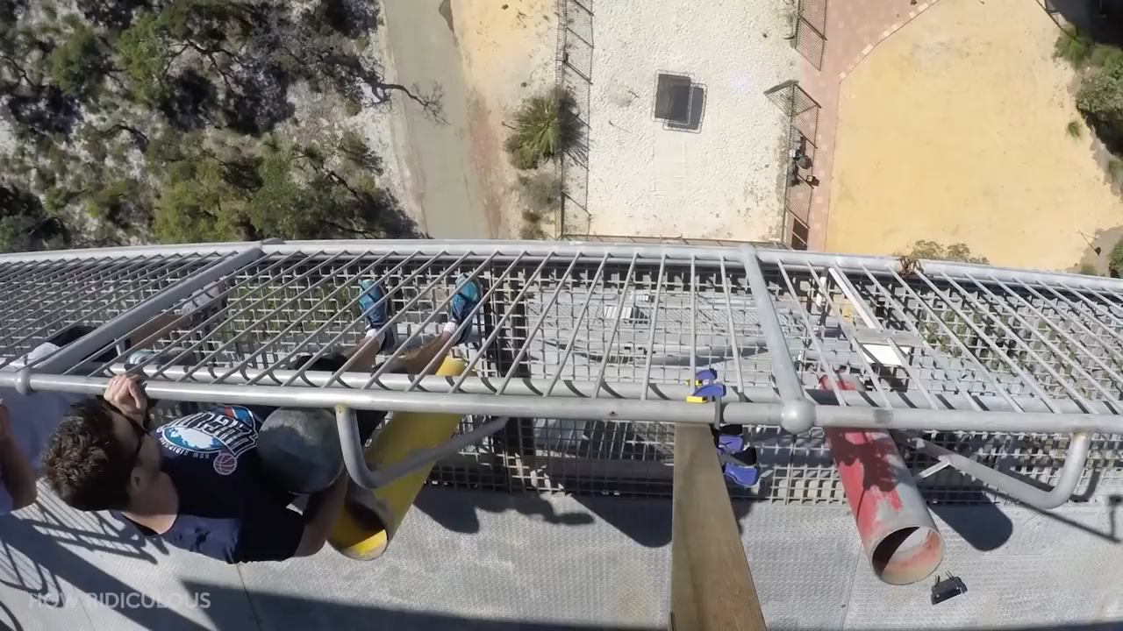
Daily Review
Reminder
When describing a force, you need to include: What is pushing / pulling what Any changes to the objects’ Speed Direction Shape
Describe the forces at work in the video below.
The ________ is pushing / pulling the ________. This is causing the ________ to change ________.
Vocabulary
force (noun) any push or pull that happens when two objects interact applied force (noun) a simple push or pull
Notes:
45 s → share → popsticks

Slide 2
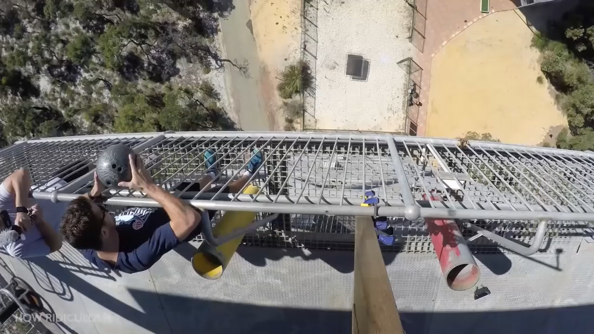
Daily Review
Reminder
When describing a force, you need to include: What is pushing / pulling what Any changes to the objects’ Speed Direction Shape
Describe the forces at work in the video below.
The ________ is pushing / pulling the ________. This is causing the ________ to change ________.
Vocabulary
force (noun) any push or pull that happens when two objects interact applied force (noun) a simple push or pull
Notes:
45 s → share → popsticks

Slide 3
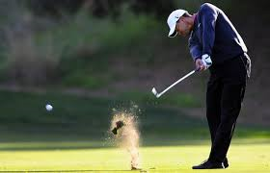

Daily Review
CFU 1
Which picture is showing a balanced force? How do you know?
Balanced and Unbalanced Forces
If the net force on an object is more than 0 N (zero Newtons), the forces on it are unbalanced. The object will change speed, direction, and / or shape.
If the net force on an object is exactly 0 N, the forces on it are balanced. The object will not change speed, direction, or shape.
CFU 2
Which picture is showing an unbalanced force? How do you know?
Vocabulary
unbalanced (adjective) forces on an object are not 0 N and will cause a change balanced (adjective) forces on an object are exactly 0 N and will not cause a change
Notes:
45 s → share → popsticks

Slide 4
Daily Review
1.
F_{cable}
2400 N
Describing and Drawing Forces
When describing forces, you need to:
Draw a diagram with labelled force arrows.
Remember: friction will resist movement!
Do the maths
Add the forces going in the same direction
Subtract the forces going in opposite directions
Describe the net force
Balanced (there is no net force)
Unbalanced (state the net force and its direction)
An elevator is going from the ground floor of a building into the basement. The Earth is pulling it downward with 5000 N of force. There are two cables attached to the top of the elevator, each of which is pulling it up with 2400 N of force. There are 200 N of friction between the elevator and the shaft.
F_{cable}
2400 N
F_{friction}
200 N
2.
2400 + 2400 + 200
= 5000
5000 – 5000
= 0
F_{gravity}
5000 N
3.
The net force is 0 N. The forces are balanced.

Slide 5
Electrostatic Force Year 7 Science

Slide 6
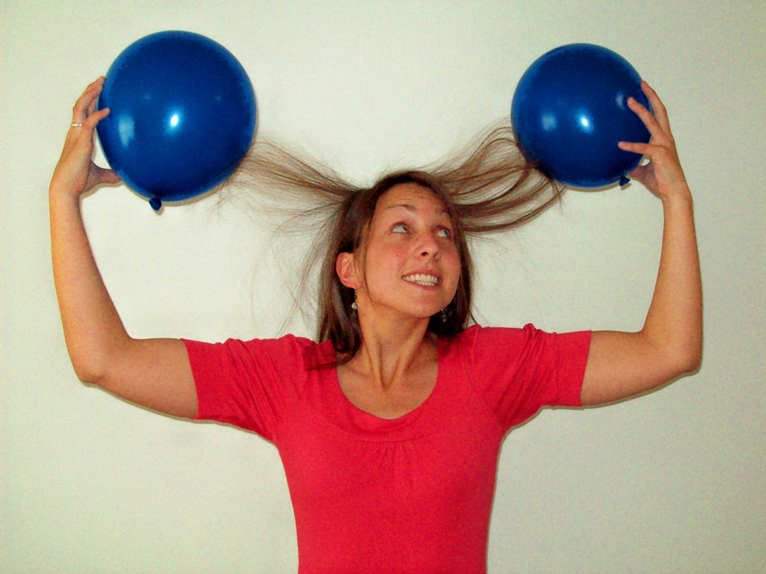
Learning Objectives
CFU
What two things can electrostatic force do to objects?
Describe and identify charge
Predict whether objects will be attracted or repelled by electrostatic force
Activate Prior Knowledge
What happens when you rub a balloon on your head?
Have you experienced this anywhere else?

Slide 7
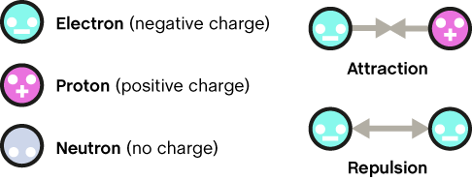
Concept Development
CFU 1
Which two particles have a charge?
Understanding Charge
Pretty much everything in the universe is made out of atoms. These atoms are made out of three even smaller things: electrons, protons and neutrons.
Some of these things have charges:
electrons always have a negative (-) charge
protons always have a positive (+) charge
neutrons are neutral (which means they have no charge)
CFU 2
What type of charge does an electron have?
CFU 3
Which part of an atom has a positive charge?
CFU 4
What does neutral mean?
Vocabulary
charge (noun) a property of matter; things can be positive, negative, or neutral (no charge)

Slide 8
Skill Development / Guided Practice
CFU 1
What would happen if two positively charged objects were close to each other?
Electrostatic Force
A difference in the net charge of two objects can create forces if the two objects are close enough.
Different (unlike) charges will be pulled towards each other (attracted)
Similar (like) charges will be pushed away from each other (repelled)
Neutral objects do not push each other away, but they are attracted to any charged object
CFU 2
What would happen if a positively charged object and a negatively charged object were close to each other?
CFU 3
What would happen if a neutral object and a negatively charged object were close to each other?
Vocabulary
like (adjective) similar or the same unlike (adjective) different

Slide 9
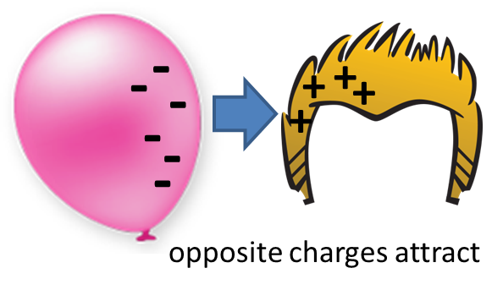
Skill Development / Guided Practice
CFU 1
Are there two different charges?
Predicting Electrostatic Force
Predict what will happen
Different charges are attracted
Similar charges are repelled
Neutral objects are attracted to charged objects
Explain why it will happen
Billie rubs a balloon on her hair, which moves negative charges from her hair to the balloon. What will happen next and why?
The balloon and her hair will be ________ because they have ________ charges.
CFU 2
Are there two similar charges?
CFU 3
Is there a neutral object and a charged object?
Vocabulary
attracted (adjective) pulled together repelled (adjective) pushed apart

Slide 10
Skill Development / Guided Practice
CFU 1
Are there two different charges?
Predicting Electrostatic Force
Predict what will happen
Different charges are attracted
Similar charges are repelled
Neutral objects are attracted to charged objects
Explain why it will happen
Mary rubs a second balloon on her hair, then puts it next to Billie’s. What will happen next and why?
The two balloons will be ________ because they have ________ charges.
CFU 2
Are there two similar charges?
CFU 3
Is there a neutral object and a charged object?
Vocabulary
attracted (adjective) pulled together repelled (adjective) pushed apart

Slide 11
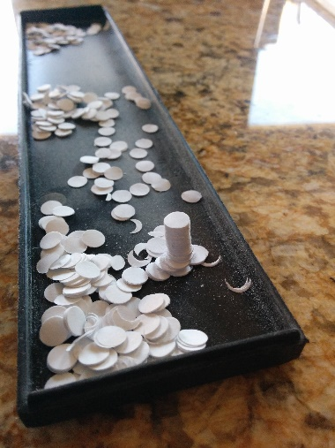
Skill Development / Guided Practice
CFU 1
Are there two different charges?
Predicting Electrostatic Force
Predict what will happen
Different charges are attracted
Similar charges are repelled
Neutral objects are attracted to charged objects
Explain why it will happen
Mary takes her balloon and holds it next to some neutral pieces of paper from her hole punch. What will happen next and why?
CFU 2
Are there two similar charges?
CFU 3
Is there a neutral object and a charged object?
Vocabulary
attracted (adjective) pulled together repelled (adjective) pushed apart

Slide 12

Skill Development / Guided Practice
CFU 1
Are there two different charges?
Predicting Electrostatic Force
Predict what will happen
Different charges are attracted
Similar charges are repelled
Neutral objects are attracted to charged objects
Explain why it will happen
Rob tries to do what Mary did, but forgets to rub his balloon on his hair. What will happen when he holds his balloon next to the paper?
CFU 2
Are there two similar charges?
CFU 3
Is there a neutral object and a charged object?
Vocabulary
attracted (adjective) pulled together repelled (adjective) pushed apart

Slide 13
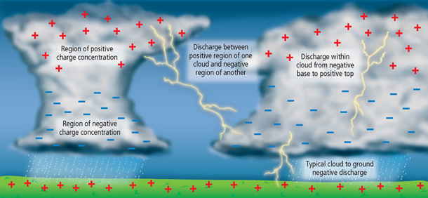
Relevance
Knowing about forces helps you to understand the world around you.
Knowing about charge is the first step to understanding:
Why you sometimes get zapped when you touch metal objects or other people
How lightning works
How laser printers work
What electricity is

Slide 14
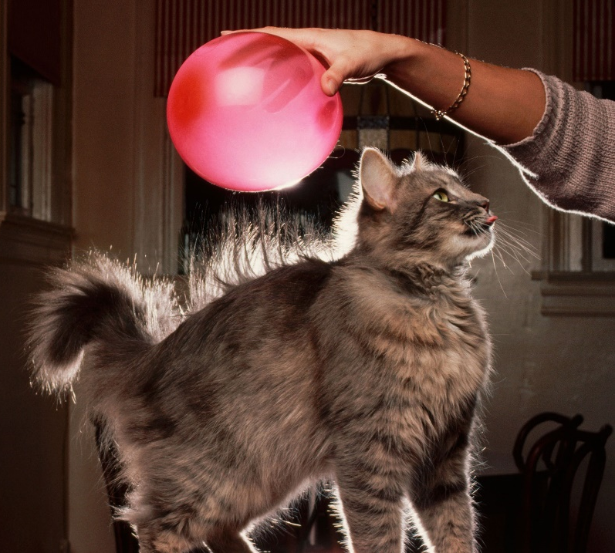
Skill Closure
Fill in the blanks: charges can be ________ or ________. An object with no charge is ________. Objects with the same charge are ________; objects with different charges are ________.
What will happen in each of the following scenarios, and why?
Neutral dust floats past a positively charged TV screen
Negatively charged glad wrap is pressed against positively charged aluminium
Two positively charged cat hairs are both pulled towards a negatively charged balloon (hint: there are two answers!)
Reminders:
Different charges are attracted Similar charges are repelled Neutral objects are attracted to charged objects

Slide 15
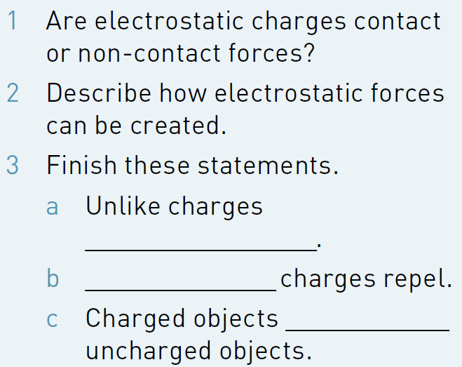
Independent Practice
Complete Questions 1-3 on p. 129 of your textbook.
Copy and complete the following table in your book or device:
 | Positive | Neutral | Negative
Positive |  |  | Attracted
Neutral
Negative

